Slide 1
Graphs – Dijkstra’s, Prim’s, Indirect Heaps
CS 3100
Readings: CLRS 23.2, 24.2, 24.3

Slide 2
Topics
Dijkstra’s algorithm + naïve runtime
Proof of correctness for Dijkstra’s algorithm
Prim’s algorithm + naïve runtime
No proof, left as exercise
Why these two algorithms? Turns out they are VERY similar
Indirect Heaps
A new data structure that makes both algorithms above more efficient

Slide 3
Dijkstra’s Algorithm

Slide 4
Weighted Shortest Path
no negative weight edges.
Dijkstra’s algorithm: uses similar ideas as the unweighted case.
Greedy algorithms:
do what seems to be best at every decision point.
v
s
S
“known”
V - S
“unknown”

Slide 5
Dijkstra’s algorithm
Initialize each vertex’s distance as infinity
Start at a given vertex s
Update s’s distance to be 0
Repeat
Pick the next unknown vertex with the shortest distance to be the next v
If no more vertices are unknown, terminate loop
Mark v as known
For each edge from v to adjacent unknown vertices w
If the total distance to w is less than the current distance to w
Update w’s distance and the path to w

Slide 6
v₀
2
v₁
2
1
5
1
1
1
v₂
v₃
v₄
6
5
3
V | Known | Dist | path
v0
v1
v2
v3
v4
v5
v6
2
10
v₅
v₆

Slide 7
void Graph::dijkstra(Vertex s){
Vertex v,w;
s.dist = 0;
while (there exist unknown vertices, find the unknown v with the smallest distance)
v.known = true;
for each w adjacent to v
if (!w.known)
if (v.dist + Cost_VW < w.dist){
w.dist = v.dist + Cost_VW;
w.path = v;
}
}
}

Slide 8
Naïve Analysis
How long does it take to find the smallest unknown distance?
simple scan using an array: O(v)
Total running time:
Using a simple scan: O(v²+e) = O(v²)

Slide 9
Dijkstra' Algorithm
dijkstra(G, wt, s)
init PQ to be empty;
PQ.Insert(s, dist=0);
parent[s] = NULL; dist[s] = 0;
while (PQ not empty)
v = PQ.ExtractMin();
for each w adj to v
if (w is unseen) {
dist[w] = dist[v] + wt(v,w)
PQ.Insert(w, dist[w] );
parent[w] = v;
}
else if (w is fringe && dist[v] + wt(v,w) < dist[w] ) {
dist[w] = dist[v] + wt(v,w)
PQ.decreaseKey(w, dist[w]);
parent[w] = v;
}

Slide 10
Analysis of Priority Queue implementation?
How long does it take to find the smallest unknown distance?
extract min from PQ: O(log(V))
But called V times total, so O(V*log(V))
Inner loop:
runs E times like before but….
Each edge could force a PQ.decreaseKey() call, runtime??
Naïve decreaseKey() is linear time: O(V), total of O(E*V)
So, total is O(V*log(V) + E*V). Is this better??

Slide 11
Dijkstra’s Proof of Correctness

Slide 12

How to Prove Correctness??
Similar to BFS, we want to prove that:
$$∀v∈V v.d=δ(s,v)$$
Let’s do this by induction. I will draw it out!

Slide 13
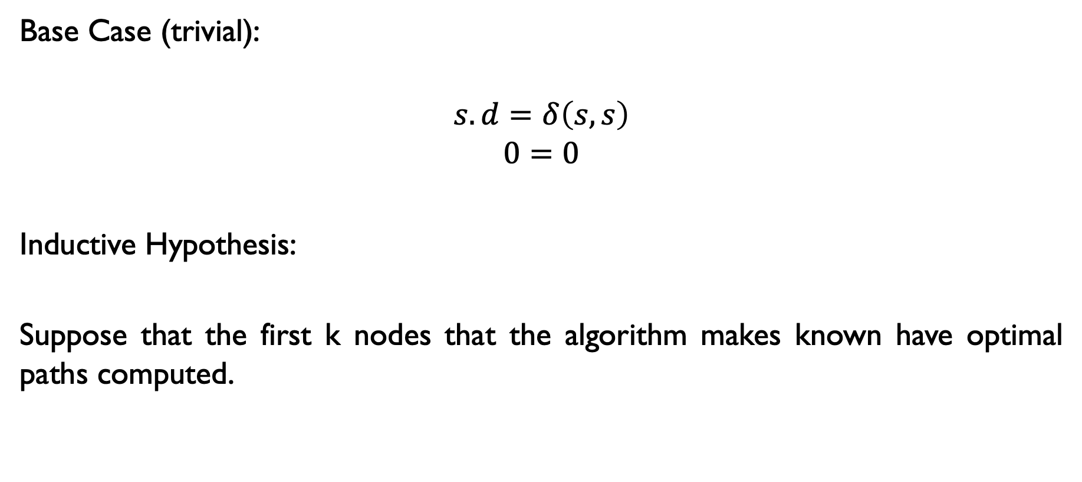
Proof w/ Picture:
Base Case (trivial):
$$s.d=δ\left(s,s\right)$$
$$0=0$$
Inductive Hypothesis:
Suppose that the first k nodes that the algorithm makes known have optimal paths computed.

Slide 14
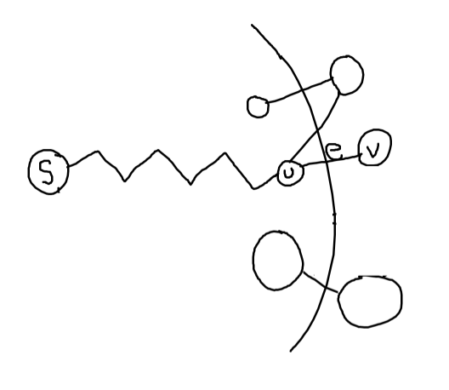
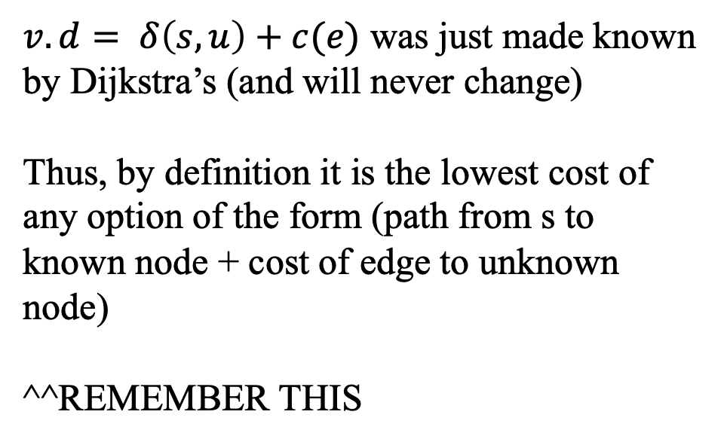
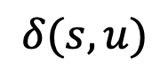
Proof w/ Picture:
$v.d= δ\left(s,u\right)+c(e)$ was just made known by Dijkstra’s (and will never change)
Thus, by definition it is the lowest cost of any option of the form (path from s to known node + cost of edge to unknown node)
^^REMEMBER THIS
$$δ(s,u)$$

Slide 15
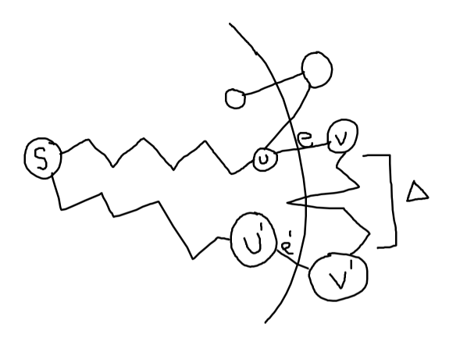
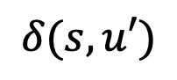
Proof w/ Picture:
Suppose (For sake of contradiction):
s to u to v is NOT the optimal way to get to v
$$δ(s,u)$$
$$δ(s,u′)$$

Slide 16
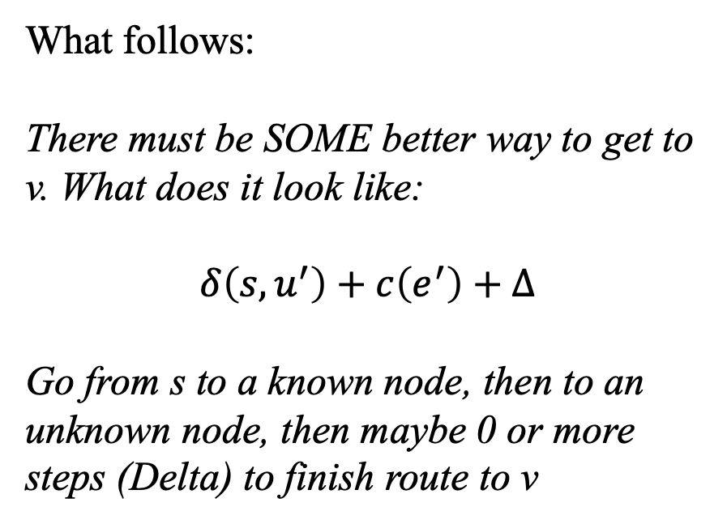
Proof w/ Picture:
Suppose (For sake of contradiction):
s to u to v is NOT the optimal way to get to v
$$δ(s,u)$$
What follows:
There must be SOME better way to get to v. What does it look like:
$$δ\left(s,u^{′}\right)+c\left(e^{′}\right)+Δ$$
Go from s to a known node, then to an unknown node, then maybe 0 or more steps (Delta) to finish route to v
$$δ(s,u′)$$

Slide 17

Formulas
$$u.d+c\left(e\right)$$
$$δ\left(s,u\right)+c\left(e\right)$$
$$δ\left(s,u^{′}\right)+c\left(e^{′}\right)+Δ<δ\left(s,u\right)+c\left(e\right)$$
$$Δ≥0$$
Path that Dijkstra chose. Best path of this form
Suppose there is a better path s (start) to u’ (known node) to v’ (unknown node) to v (end node) where e’ = (u’, v’)
Delta must be greater than 0 because this is requirement of input

Slide 18

Formulas
$$u.d+c\left(e\right)$$
$$δ\left(s,u\right)+c\left(e\right)$$
$$δ\left(s,u^{′}\right)+c\left(e^{′}\right)+Δ<δ\left(s,u\right)+c\left(e\right)$$
$$Δ≥0$$
$$δ\left(s,u^{′}\right)+c\left(e^{′}\right)<δ\left(s,u\right)+c(e)$$
Path that Dijkstra chose. Best path of this form
Suppose there is a better path s (start) to u’ (known node) to v’ (unknown node) to v (end node) where e’ = (u’, v’)
Delta must be greater than 0 because this is requirement of input
Delta gets removed and inequality still holds (left side may get even smaller
This is a CONTRADICTION. If this equation were true, Dijkstra’s algorithm would have selected v’ as the next known node.

Slide 19
Prim’s Algorithm

Slide 20
Spanning Tree
A spanning tree of a graph G is a subgraph of G that contains every vertex in G and is also a tree (i.e., it has no cycles)
All connected graphs have spanning tree(s)
All spanning trees have the same number of nodes (all of them)
You can construct a spanning tree by arbitrarily remove edges from cycles

Slide 21
Spanning Tree: Example
Original Graph:
Possible spanning trees:

Slide 22
Spanning Tree: Example (almost)

Slide 23
Minimum Spanning Tree
Just constructing any spanning tree is simple
Suppose edges have costs!
Cost of building tracks between two stations
Length of wire between boxes in a house
Each spanning tree has a different total cost (sum of edges included in tree)
The Minimum Spanning Tree is the spanning tree with lowest overall cost

Slide 24
Minimum Spanning Tree
Given a connected and undirected graph G=(V, E)
Find a graph G’ = (V, E’) such that:
E’ is a subset of E
|E’| = |V| - 1
G’ is connected (assuming G was connected)
Sum of cost of edges in E’ is minimum
G’ is then the minimum spanning tree

Slide 25
Prim’s algorithm
Idea: Grow a tree by adding an edge from the “known” vertices to the “unknown” vertices. Pick the edge with the smallest weight.
G
v
known
Notes:
Pick one node as the root,
Incrementally add edges that connect a “new” vertex to the tree.
Pick the edge (u,v) where u is in the tree, v is not AND
where the edge weight is the smallest of all edges (where u is in the tree and v is not).

Slide 26
Prim’s Algorithm for MST
Pick one node as the root,
Incrementally add edges that connect a “new” vertex to the tree.
Pick the edge (u,v) where:
u is in the tree, v is not AND
where the edge weight is the smallest of all edges (where u is in the tree and v is not).

Slide 27
MST
2
v₂
v₁
4
1
3
10
v₃
2
v₄
7
v₅
5
8
4
6
v₆
1
v₇

Slide 28
MST
v1
{v1, v4}
{v1, v2}
{v4, v3}
{v4, v7}
{v7, v6}
{v7, v5}
2
v₂
v₁
4
1
3
10
v₃
2
v₄
7
v₅
5
8
4
6
v₂
v₁
v₆
1
v₇
v₃
v₄
v₅
v₇
v₆

Slide 29
Prim’s MST Algorithm
Greedy strategy:
Choose some start vertex as current-tree
Greedy rule: Add edge from graph to current-tree that
has the lowest weight of edges that…
have one vertex in the tree and one not in the tree.
Thus builds-up one tree by adding a new edge to it
Can this lead to an infeasible solution? (Tell me why not.)
Is it optimal? (Yes. Need a proof.)

Slide 30
Tracking Edges for Prim’s MST
Candidate edges: edge from a tree-node to a non-tree node
Since we’ll choose smallest, keep only one candidate edge for each non-tree node
But, may need to make sure we always have the smallest edge for each non-tree node
Fringe-nodes: non-trees nodes adjacent to the tree
Need data structure to hold fringe-nodes
Priority queue, ordered by min-edge weight
May need to update priorities!

Slide 31
Prim’s Algorithm
MST-Prim(G, wt)
init PQ to be empty;
PQ.Insert(s, wt=0);
parent[s] = NULL;
while (PQ not empty)
v = PQ.ExtractMin();
for each w adj to v
if (w is unseen) {
PQ.Insert(w, wt(v,w));
parent[w] = v;
}
else if (w is fringe && wt[v,w] < fringeWt(w)){
PQ.decreaseKey(w, wt[v,w]);
parent[w] = v;
}

Slide 32
Cost of Prim’s Algorithm
Looks VERY similar to Dijkstra’s doesn’t it!!
Outer loop extracts from PQ total of V times
O(V*log(V))
Inner loop runs E times total, but calls decreaseKey()
If decreaseKey() is naïve and linear (V), then
O(E*V)
Total: O(V*log(V) + E*V)

Slide 33
Indirect Heaps

Slide 34
Compare
Both Dijkstra and Prim have same structure, and suffer from a naïve, slow implementation of decreaseKey()
Let’s compare the code real fast, and then introduce the Indirect Heap

Slide 35
Dijkstra' Algorithm
dijkstra(G, wt, s)
init PQ to be empty;
PQ.Insert(s, dist=0);
parent[s] = NULL; dist[s] = 0;
while (PQ not empty)
v = PQ.ExtractMin();
for each w adj to v
if (w is unseen) {
dist[w] = dist[v] + wt(v,w)
PQ.Insert(w, dist[w] );
parent[w] = v;
}
else if (w is fringe && dist[v] + wt(v,w) < dist[w] ) {
dist[w] = dist[v] + wt(v,w)
PQ.decreaseKey(w, dist[w]);
parent[w] = v;
}

Slide 36
Prim’s Algorithm
MST-Prim(G, wt)
init PQ to be empty;
PQ.Insert(s, wt=0);
parent[s] = NULL;
while (PQ not empty)
v = PQ.ExtractMin();
for each w adj to v
if (w is unseen) {
PQ.Insert(w, wt(v,w));
parent[w] = v;
}
else if (w is fringe && wt[v,w] < fringeWt(w)){
PQ.decreaseKey(w, wt[v,w]);
parent[w] = v;
}

Slide 37
Better PQ Implementations
Goal: Lower cost of PQ.decreaseKey()
Example of naïve approach first →

Slide 38
Better PQ Implementations
Goal: Lower cost of PQ.decreaseKey()
Indirect Heap →

Slide 39
Better PQ Implementations (2)
Cost of Dijkstra’s and Prim’s
O(V*log(V) + E*V)
Indirect heap makes bolded V become log(V)
New Cost:
O(V*log(V) + E*log(V)) = O(E*log(V))

Slide 40
Summary

Slide 41
What Did We Learn?
Review of Dijkstra’s and Prim’s
Almost same algorithm but solve different problems!!
Review of Naïve runtime analysis
Indirect heap and better runtime for each algorithm

Slide 42
Extra Problem (If Time Allows)

Slide 43
Solve This Problem
Suppose Floryan is traveling by flying from city S to city D. Floryan doesn’t mind sitting on planes, but he REALLY dislikes layovers in airports (I mean, you are just SITTING there not making any progress).
Given Floryan’s start city S, destination city D, and a long list of flights (each flight is start city, end city, departure date/time, arrival date/time), can you find the optimal itinerary that minimizes Floryan’s layover time?

Slide 44
Solution:

